Slide 1
Lucky People
input:
person
person
sex
first name
last name
day of birth
month of birth
output: lucky?
sex | enumeration | Male | Female
firstName | string | [A-Z][a-z]*
lastName | string | [A-Z][a-z]*
dayOfBirth | integer | 1 <= dayOfBirth <= 31
monthOfBirth | integer | 1 <= monthOfBirth <= 12
Notes:
Person: cartesian product of
Sex : enumaration of Male and Female
Names: strings
Day and month of birth: integers
Data constraints:
Regular expression on names

Slide 2


Lucky People
A person is lucky when either
the first character of the first name is equal to the first character of the last name,

Slide 3


Lucky People
A person is lucky when either
the first character of the first name is equal to the first character of the last name,
the day of birth is equal to the month of birth, or
2 - 2 - 1977
9 - 9 - 1975
Notes:
Shakira - https://nl.wikipedia.org/wiki/Shakira
Michel Bublé - https://nl.wikipedia.org/wiki/Michael_Bubl%C3%A9

Slide 4
Lucky People
A person is lucky when either
the first character of the first name is equal to the first character of the last name,
the day of birth is equal to the month of birth, or
the person is a Female after five Males or a Male after five Females.
…MMMMMF…
…FFFFFM…

Slide 5
Lucky People
A person is lucky when either
the first character of the first name is equal to the first character of the last name,
the day of birth is equal to the month of birth, or
the person is a Female after five Males or a Male after five Females.
input:
person
state ::= (last,n)
n := 0
output: lucky ::= ( sex(person) != last ˄ n ≥ 5 ) ˅ …
state update:
IF last == sex(person) THEN n := n+1 ELSE last := sex(person) ; n := 1

Slide 6
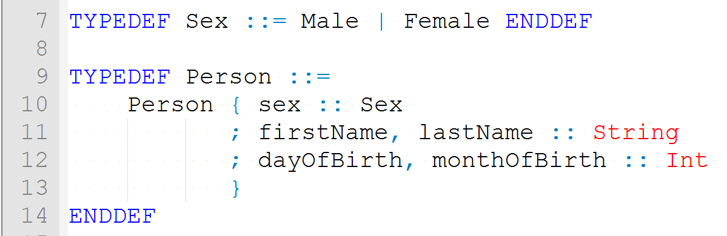
Lucky People – TorXakis model
person
sex
first name
last name
day of birth
month of birth
sex | enumeration | Male | Female
firstName | string | [A-Z][a-z]*
lastName | string | [A-Z][a-z]*
dayOfBirth | integer | 1 <= dayOfBirth <= 31
monthOfBirth | integer | 1 <= monthOfBirth <= 12

Slide 7
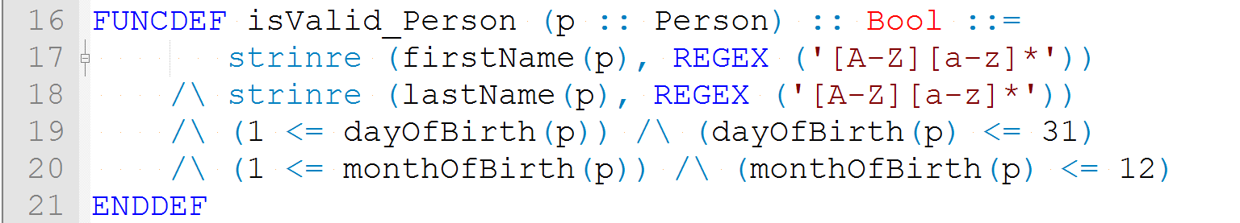
Lucky People – TorXakis model
sex | enumeration | Male | Female
firstName | string | [A-Z][a-z]*
lastName | string | [A-Z][a-z]*
dayOfBirth | integer | 1 <= dayOfBirth <= 31
monthOfBirth | integer | 1 <= monthOfBirth <= 12

Slide 8
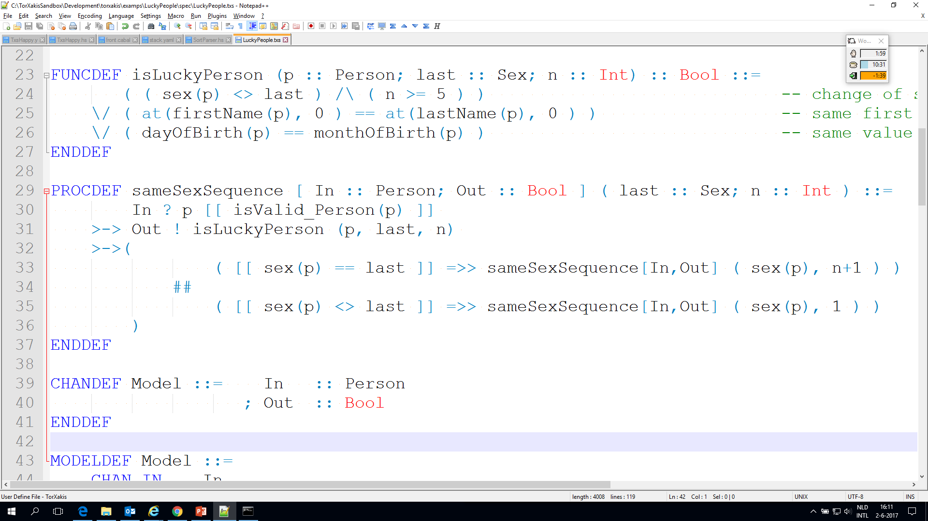
Lucky People – TorXakis model
input:
person
state ::= (last,n)
n := 0
output: lucky ::= ( sex(person) != last ˄ n ≥ 5 ) ˅ …
state update:
IF last == sex(person) THEN n := n+1 ELSE last := sex(person) ; n := 1
Notes:
Recursive call -> requires procdef with name to refer to: sameSexSequence

Slide 9
Lucky People – TorXakis model
input:
person
state ::= (last,n)
n := 0
output: lucky ::= ( sex(person) != last ˄ n ≥ 5 ) ˅ …
state update:
IF last == sex(person) THEN n := n+1 ELSE last := sex(person) ; n := 1

Slide 10
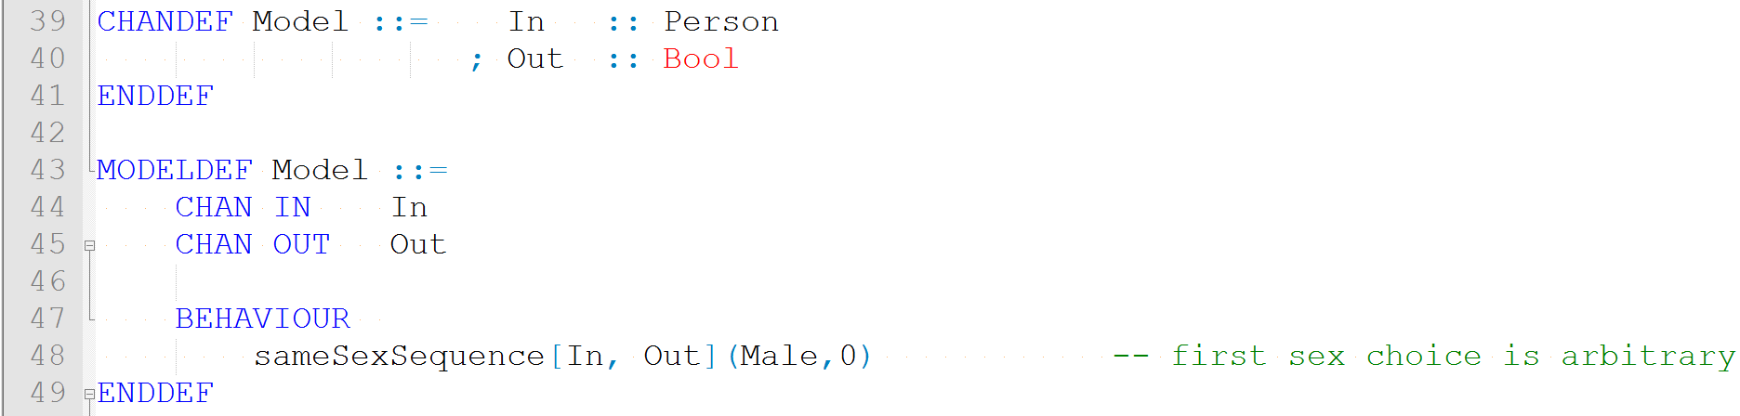
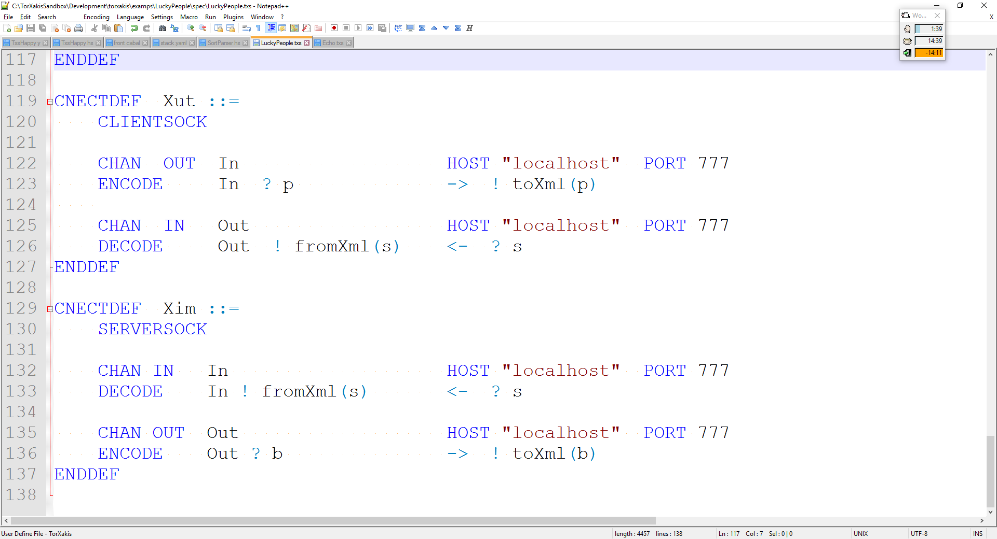
Lucky People – TorXakis model
Notes:
Xut – Xml communicating SUT

Slide 11
Simulator
Test Driven Development
SUT not yet available
TorXakis can act as simulator
Notes:
Xim – Xml communicating Sim(ulator)

Slide 12
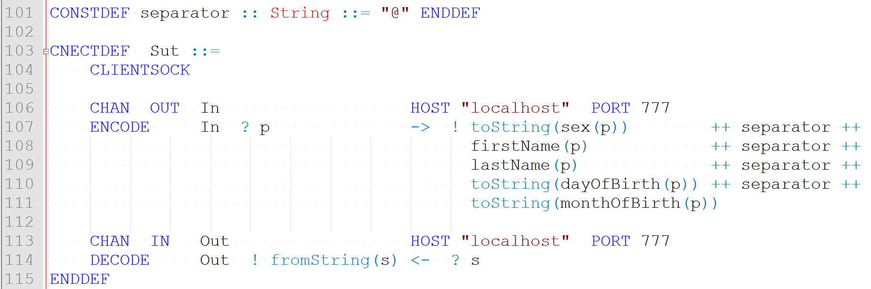
System Under Test
SUT available
Specific encoding

Slide 13
Demo

